Slide 1
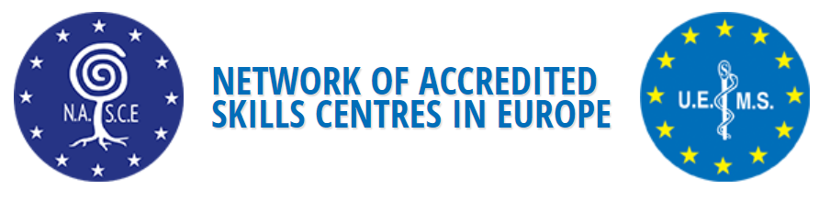
Multidisciplinary Joint Committee
of the UEMS
Notes:
Slides PFR

Slide 2

NASCE
Network of Accredited Skills Centres in Europe
Founded as Multidisciplinary Joint Committee of UEMS Stockholm, 2014
  Certify highest standards of education (patient safety)
  Advance science of clinical education, training and assessment
  Enhance standards for operation of Clinical Skills Centres through assessment and accreditation
Notes:
The primary aim of the Multidisciplinary Joint Committee (14 groups) is to certify the highest standards of education for surgeons, physicians and other learners in order to promote patient safety.
2.3. – The Multidisciplinary Joint Committee aims to advance the science of clinical education, training, and assessment.
2.4 - The intent of the Multidisciplinary Joint Committee is to enhance the standards for the operation Clinical Skills Centres, through assessment and accreditation.
Rigorous process including several meetings proceeded the launch of NASCE

Slide 3

Who can apply for NASCE accreditation?
Any training centre with an appropriate steering board.
Centres can be accredited at two levels: single specialty or multispeciality format centre.
NASCE accredits the centre but does NOT accredit specific skills courses or content per se.
Centres outside UEMS area can apply.
Accreditation is an on-going process of development and yearly membership of NASCE is required if accredited status is used in any documents related to the centre.

Slide 4
Organogram
Notes:
NASCE members = accredited centers
NASCE council = governing council – national representatives and representatives of NASCE supporting UEMS sections, full voting members at GA
Executive board = Anders Bergenfelz chairman, Paul Ridgway honorary secretary, treasurer Torben Schroeder, Member at large Emin Aksoy, Chairman of ARB Oscar Traynor – nowadays Emin Aksoy chairman, Apostolos honorary secretary, Teuvo A

Slide 5
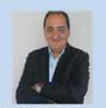
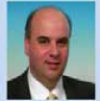
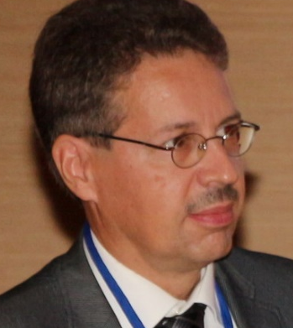
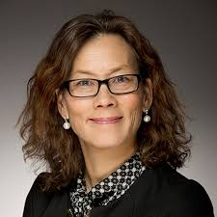
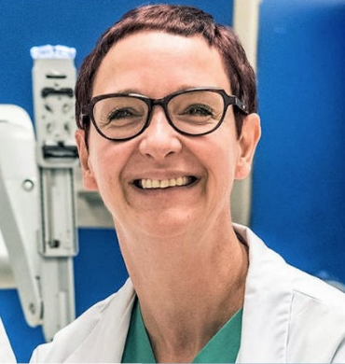
Organogram – NASCE Executive Board
Chairman | Emin Aksoy CASE
Secretary | Apostolos Papalois SUBRE
Treasurer | Teuvo Antikainen Center of Healthcare Expertise
Member at large | Li Felländer Tsai CAMST
Chair ARB | Isabelle Van Herzeele ITCIT
Notes:
Picture of Apostolos to be added

Slide 6
Organogram –ARB Board
Name | Country | Centre | Specialty
Emin Aksoy | Turkey | CASE | Family Medicine/Biomedical Engineer
Teuvo Antikainen | Finland | Centre of Healthcare Expertise | Surgeon
Anders Bergenfelz | Sweden | Practicum Lund | Surgeon
Li Felländer Tsai | Sweden | CAMST | Orthopaedic surgeon
Dilek Kitapcioglu | Turkey | CASE | Anaesthesiologist
Dara O’Keeffe | Ireland | RCSI | Surgical education
Apostolos Papalois | Greece | SUBRE | Biologist
Paul Ridgway | Ireland |  | Surgeon
Erhan Sayali | Turkey | CASE | Family Medicine
Vinod Singhal | Dubai |  | Surgeon
Nicla Settembre | France | University of Lorraine | Vascular Surgeon
Oscar Traynor | Ireland | RCSI | Surgeon
Isabelle Van Herzeele | Belgium | ITCIT | Vascular Surgeon
Cecilie Vapenstad | Norway | NSALK | Research Scientist
Wouter Willaert | Belgium | ITCIT | Surgeon
Juriy Wladimiroff | UK |  | Obstetrics & Gyn
…
Notes:
Pictures to be added

Slide 7

Headers for Accreditation
Governance
Centre director, Steering board, Organogram, Mission statement, SOP, at least 4 meetings …
Administration
Staff, inventory, budget, audit mechanism, website, technical support …
Teachers
Skills training , 3WTE dedicated teaching role, higher qualifications
Learners
Under-and postgraduates, inter-disciplinary, inter-professional, remote monitoring, range of modern techniques (SBE, e-learning…), seminar room...
Competencies
Technical, non-technical, train the trainer
R&D
Research in area of skills delivery/acquisition/performance, feedback, formal audit,
innovative approaches to learning and education, SWOT analysis, 4 year mission plan…
Notes:
Have an appointment for at least 2 years, with dedicated funding for at least a further 2 yrs – at least 25% of time to the centre if other commitments
Affiliation with academic or clinical institution accredited by relevant national body…

Slide 8
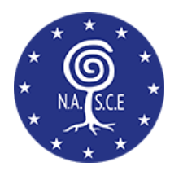
Initial Accreditation Process
Application request
ARB chair
Documents reviewed by ARB chair & co-chair
ARB sends two site surveyors from different countries
Accreditation Visit
Initial report from the site surveyors sent to ARB < 2 weeks
ARB Commitee recommends to NASCE EB < 6 weeks
Approved by
NASCE EB
Accreditation Diploma
Notes:
During the pandemic this visit was done virtually
Survey report written and sent to ARB within 2 weeks, reviewed by the members of ARB, ARB as a whole votes on recommendation (< 6 weeks)
Cost for application including first year’s accreditation fee 3000 Euro for Europe, 4000 Euro outside of Europe PLUS travel expenses of surveyors and accommodation

Slide 9
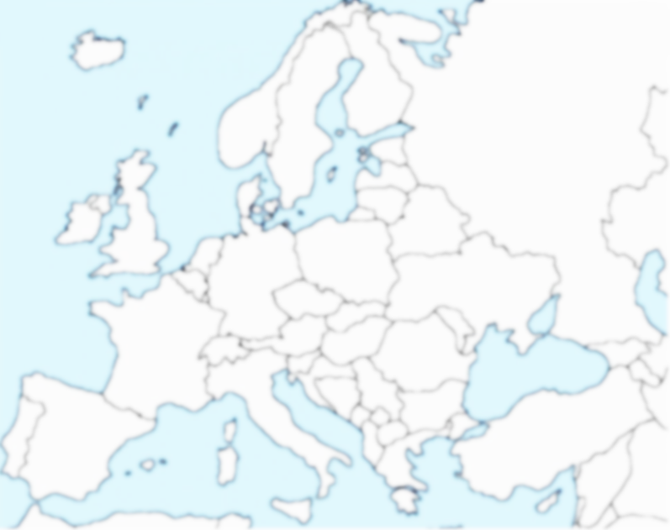

NASCE Accredited Centers
Centre of Healthcare Expertise
CAMST
NSALK
PRACTICUM
RCSI
ICAPPS
ITCIT
ORSI
SFITS
Hopital Virtuel de Lorraine
CASE
SUBRE
ELPEN
Notes:
CASE Center of Advanced simulation and education, Istanbul, Turkey
Practicum Clinical Skills Center, Lund (Malmö) Sweden
Royal College of Surgeons Ireland, Dublin, Ireland
Institute for Training and Clinical Innovative Technology Gent, ITCIT, Gent, Belgium
Centre of Healthcare expertise, Finland
NSALK Norwegian National Advisory Unit on Advanced Laparoscopic Surgery NSALK, Trondheim, Norway – single center
ORSI Academy, Melle, Belgium
Experimental Educational and Research center Elpen, Greece
Hopital Virtuel de Lorraine, Nancy, France
CAMST Center for advanced medical simulation and training at Karolinska University hospital, Stockholm, Sweden
SUBRESpecial unit for biomedical research and education, school of medicine, Aristotle university of Thessaloniki, Greece
ICAPSS The irish centre of applied patient safety and simulation
SFITS – Swiss Foundation for Innovation and Training in Surgery, Geneva, Switzerland - interest has been declared, paperwork under review
MidtSim, Central Denmark Region , will stop accreditation in 2023
CAMES Copenhagen Academy for Medical Education and Simulation – stopped accreditation 2023

Slide 10

Benefits
Accreditation of multi-specialty centres, NO focus on a single specialty
Notes:
Collaborate, network, and share best practices with centers that are at the forefront of simulation-based education and training
Follow our roadmap to a strong surgical simulation program as described by the requirements of the ACGME
Engage in a standardized, rigorous review process
Enjoy exclusive access to educational resources
Present your original research with the potential to be published in Surgery
Gain a marketing advantage and strengthen your recruiting efforts

Slide 11
Benefits
Standardized, rigorous review process
  Be HEARD!
  Multi-disciplinary, Inter-disciplinary, Inter-professional
  SWOT analysis Strengths, Weaknesses, Opportunities, Threats
  Constructive feedback
  Accreditation by an Official European Organization (NASCE – UEMS)
Notes:
Collaborate, network, and share best practices with centers that are at the forefront of simulation-based education and training
Follow our roadmap to a strong surgical simulation program as described by the requirements of the ACGME
Engage in a standardized, rigorous review process
Enjoy exclusive access to educational resources
Present your original research with the potential to be published in Surgery
Gain a marketing advantage and strengthen your recruiting efforts

Slide 12

Benefits
Increased recognition
internationally by non-commercial
and commercial organizations
Notes:
Marketing advantage: more financial support and easier to recruit delegartes

Slide 13
Benefits
Collaborate, network and share expertise within your centre and other accredited NASCE centres, at the forefront of Simulation-Based Education and training in Europe and beyond
  Share Best practices
  Exchange training ideas
  Joined Research
  Train the trainer courses
  Train the simulation technician courses
Notes:
Follow our roadmap to a strong surgical simulation program as described by the requirements of the ACGME
Engage in a standardized, rigorous review process
Enjoy exclusive access to educational resources
Present your original research with the potential to be published in Surgery
Gain a marketing advantage and strengthen your recruiting efforts

Slide 14
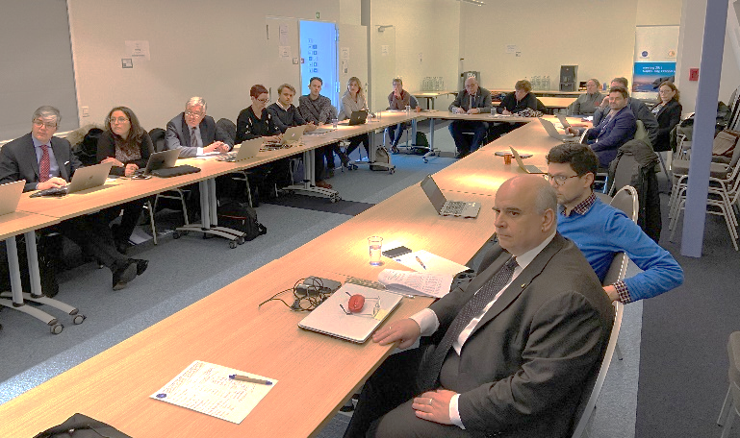
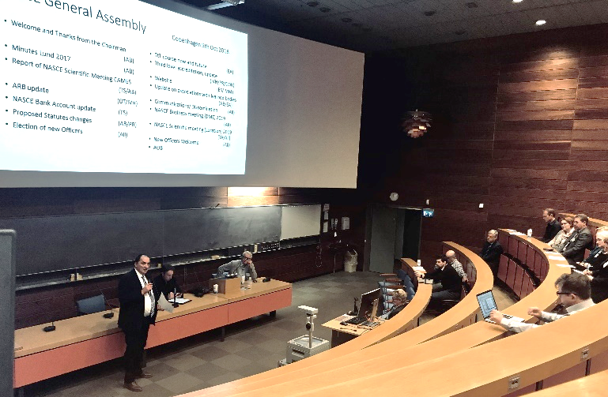
Two Meetings Each Year
NASCE Business Meeting
  at Domus Medica Europaea in Brussels
NASCE Scientific Meeting
  Organized by NASCE accredited centre(s) locally
Notes:
Marketing advantage: more financial support and easier to recruit delegartes

Slide 15
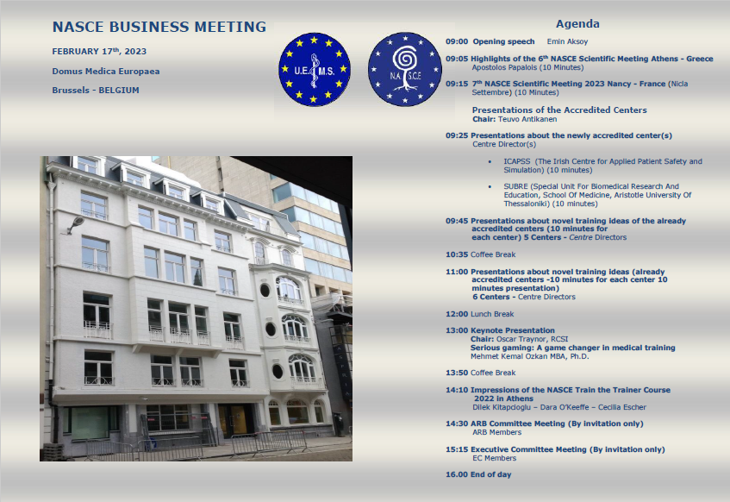
NASCE Business Meeting
Notes:
Marketing advantage: more financial support and easier to recruit delegartes

Slide 16
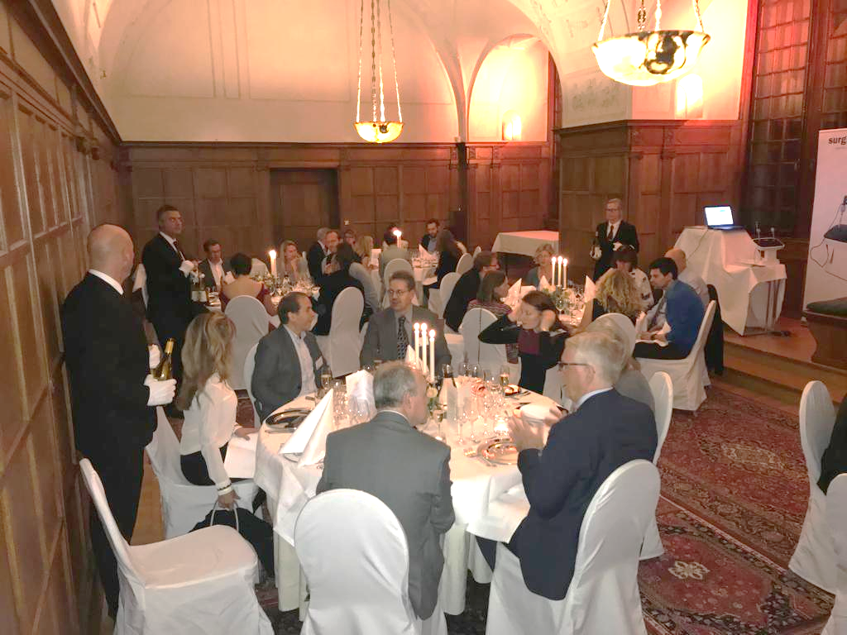

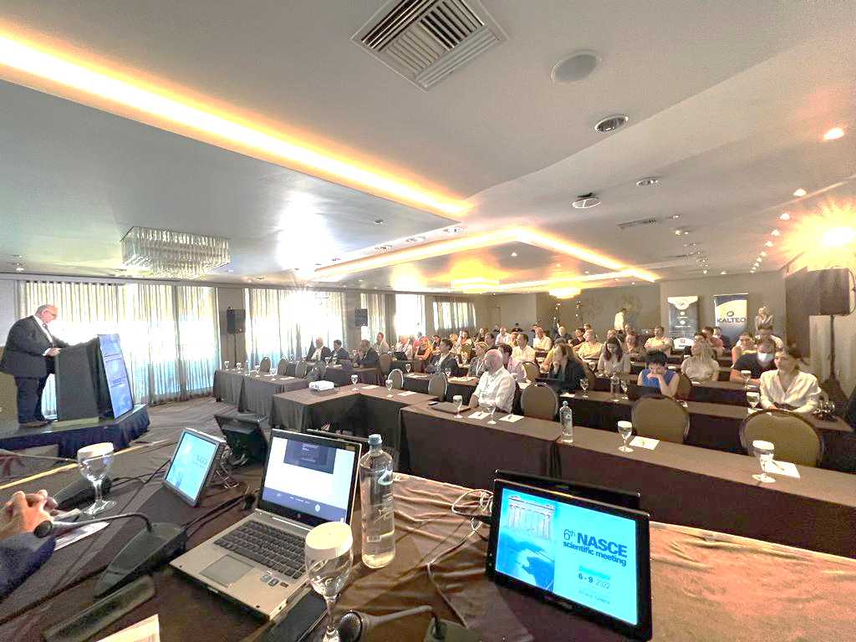
Scientific Meetings
2015
Istanbul
2016
Dublin
2017
Lund
2018
Copenhagen
2019
Stockholm
2020
2021
Online
2022
Athens
2023
Nancy

Slide 17
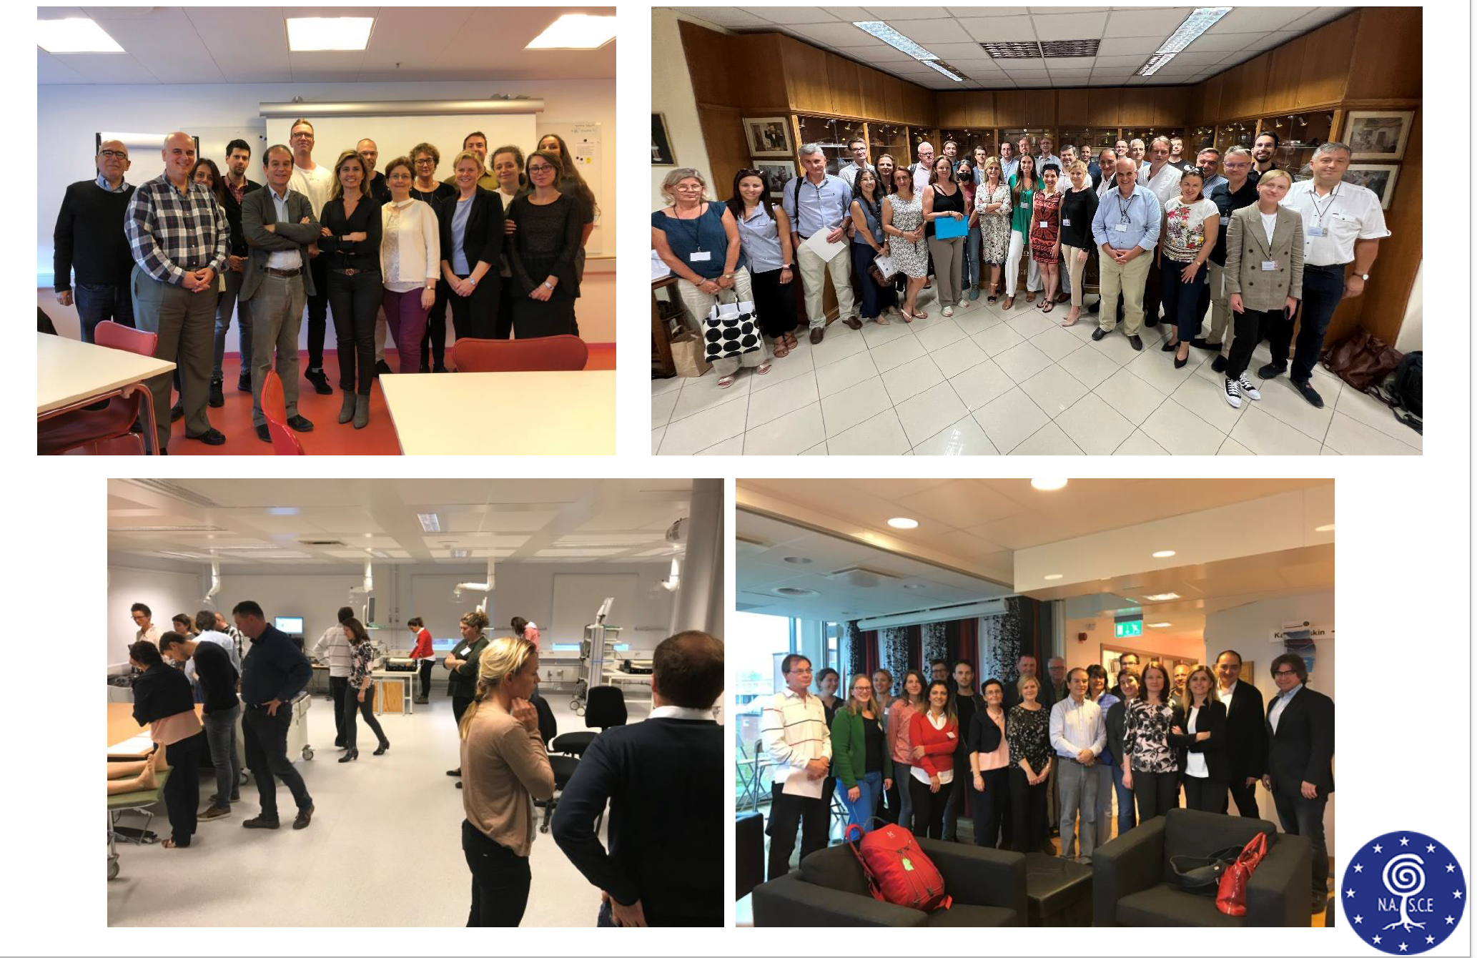
Train The Trainer Courses
Tutors: Dara O’Keeffe, Cecilia Escher, Dilek Kitapcioglu, Michail Sideris
Notes:
Marketing advantage: more financial support and easier to recruit delegartes

Slide 18
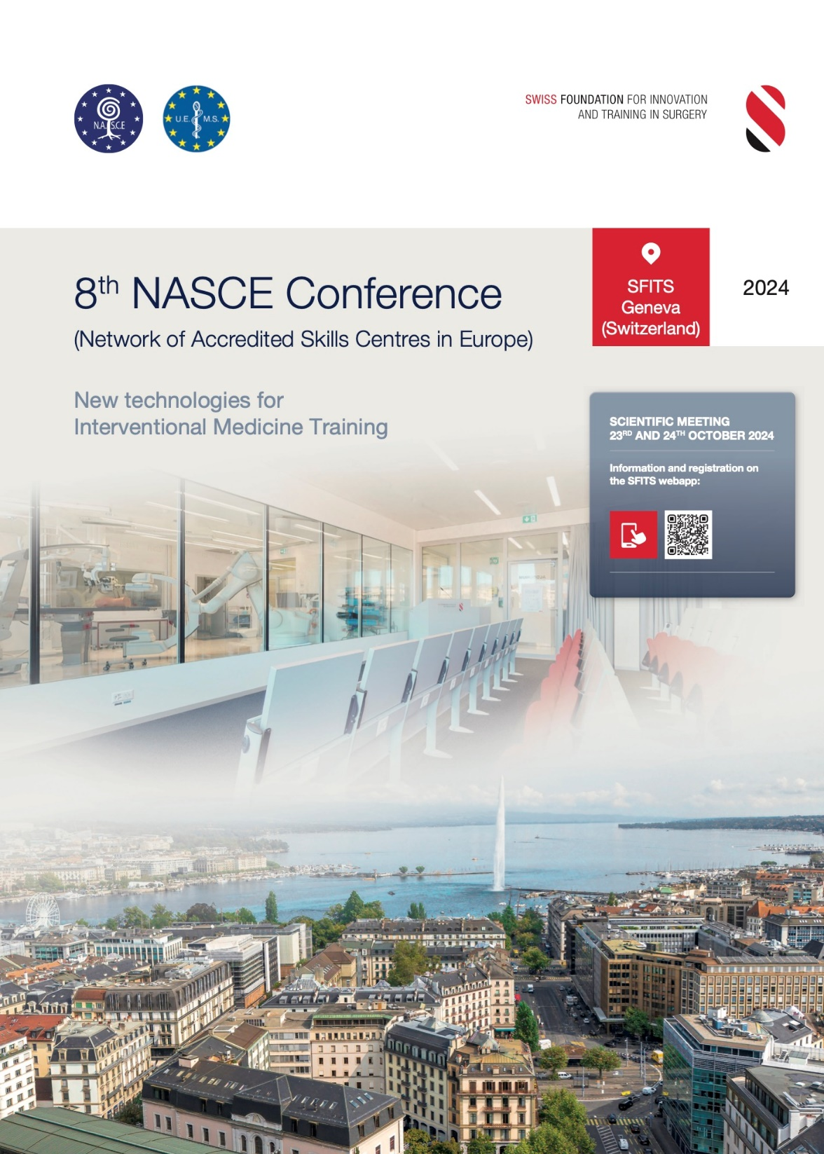
www.nascenet.org
secretariat@uems.eu
isabelle.vanherzeele@ugent.be
daraokeeffe@rcsi.ie
Notes:
Details, Q&A, forms for application

